Slide 1


Slide 2
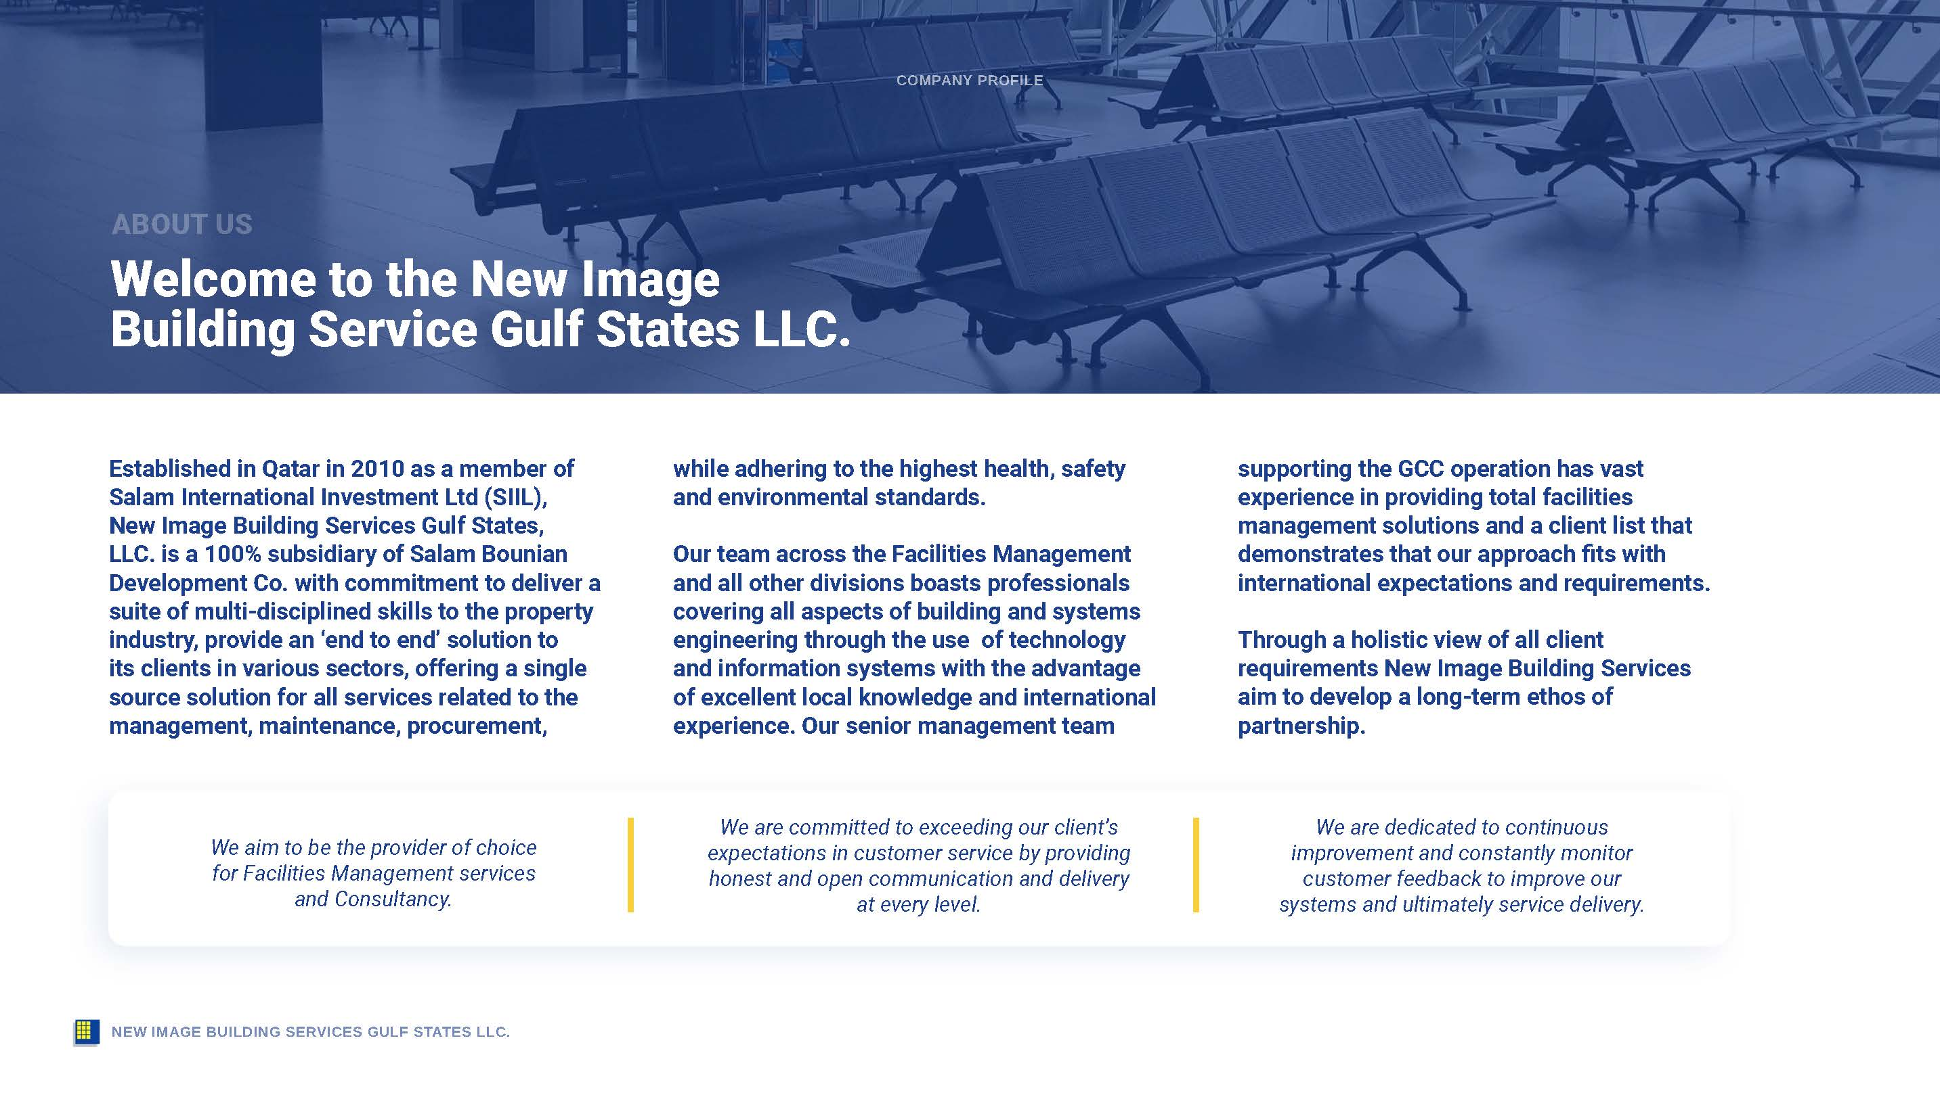

Slide 3
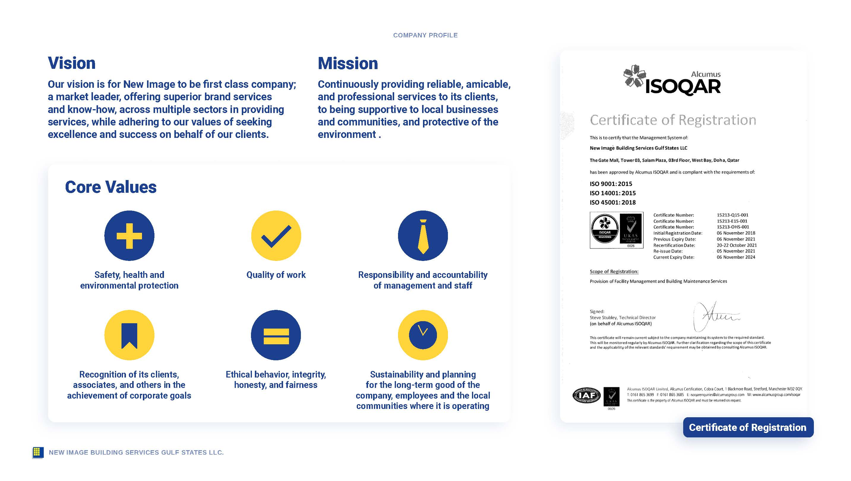

Slide 4
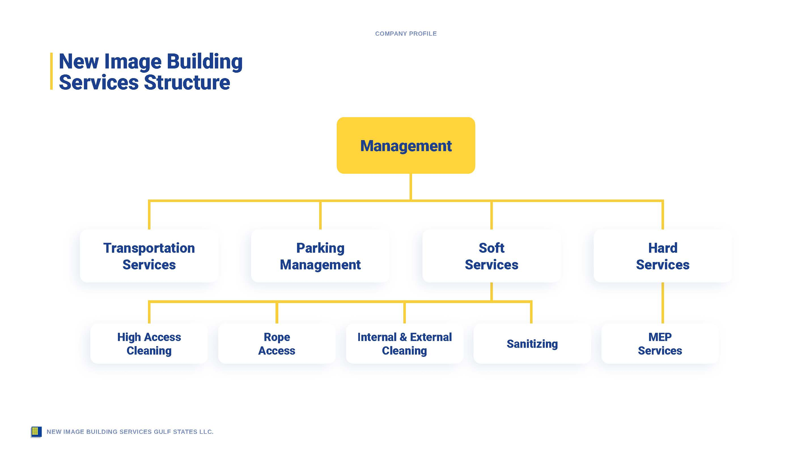

Slide 5
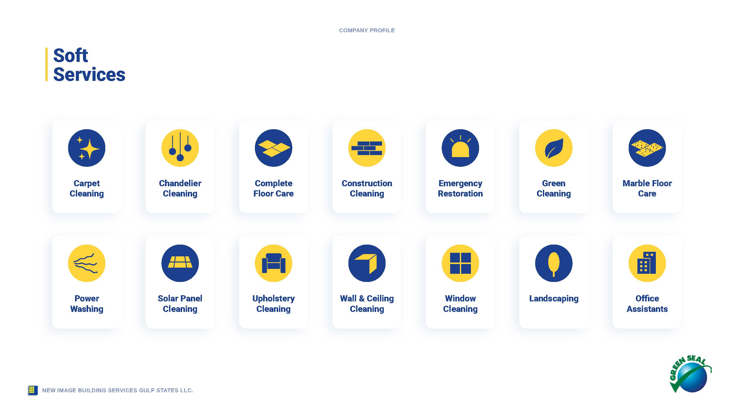

Slide 6


Slide 7


Slide 8
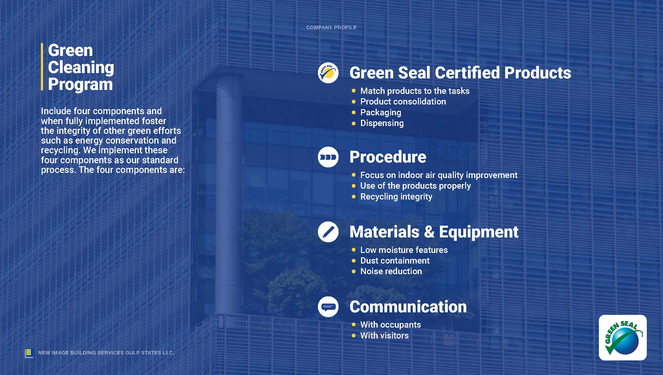

Slide 9

Valet and Parking Services
Landscaping Maintenance
Pest Control
Specializes in landscape design, landscape construction, landscape installation, and landscape maintenance. Mowing, mulching, edging, pruning, and other lawn care maintenance duties.
Specializes in inspects commercial and residential properties for pests and eliminates pests such as rodents, termites, and bed bugs when there is an infestation.
Specializes in parking revenue generation, equipment provision and maintenance, staffing and management of various parking needs to effectively service the requirements of the facility.
Drop off greeting and experience ​
Two customer service agents at each location VVIP​
Retrieval coordinator in Parking lot​
Cashier fixed point of payment​
Day / Night difference in service level?
Do general lawn care duties like groundskeeping, and lawn maintenance including mowing, raking, mulching, weeding, fertilizing, edging, and pruning
Assist your team with customers’ landscape design, landscape construction, landscape installation, and landscape maintenance
Tend to flower beds using a sprinkler or irrigation system
Apply pesticide as needed for weed control
Complete detailed daily reports of work
Advise clients on how to maintain their landscaping design after work is completed
Assess customer property to identify warning signs of potential pest problems, such as termites, bed bugs, vermin, rodents, or other unwanted pests
Provide guidance for the best extermination processes for the identified infestation source and whether the process will include pesticide use, mechanical traps, blockages, and/or other pest control methods
Measure area dimensions and mix the correct amount of chemicals in the applicator based on the size of the infested area
Spray the necessary pesticides in appropriate areas of infestation
Follow safety procedures and product instructions at all times when using fumigants and power spraying equipment, such as wearing protective gear
NEW IMAGE BUILDING SERVICES GULF STATES LLC.

Slide 10
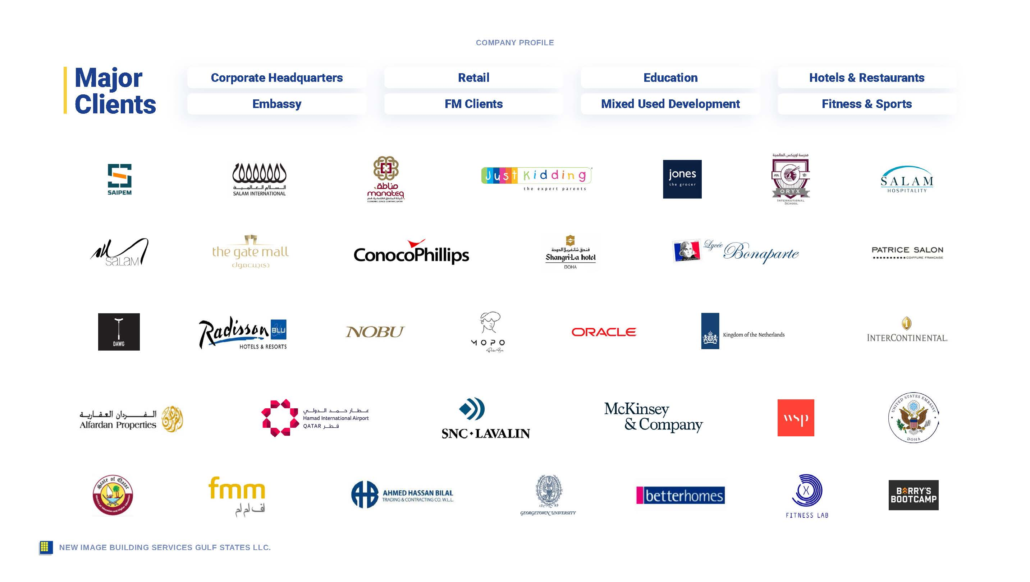


Slide 11


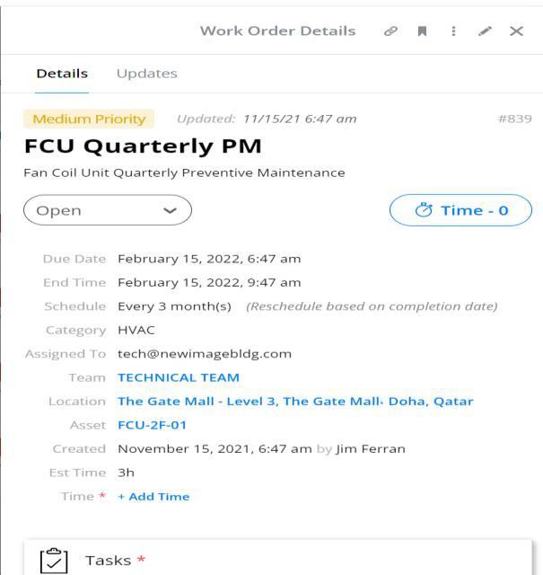
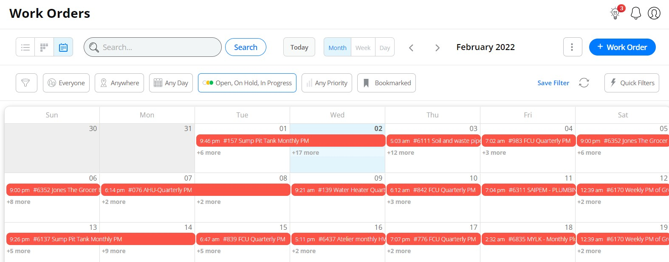
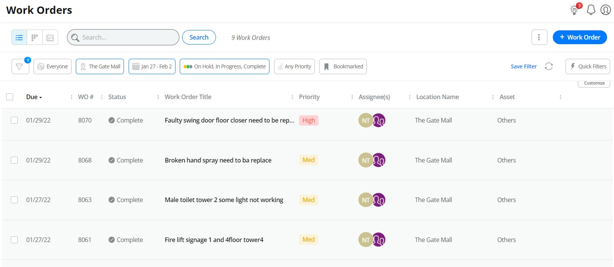
COMPUTER AIDED FACILITY MANAGEMENT (CAFM) SYSTEM
11

Slide 12
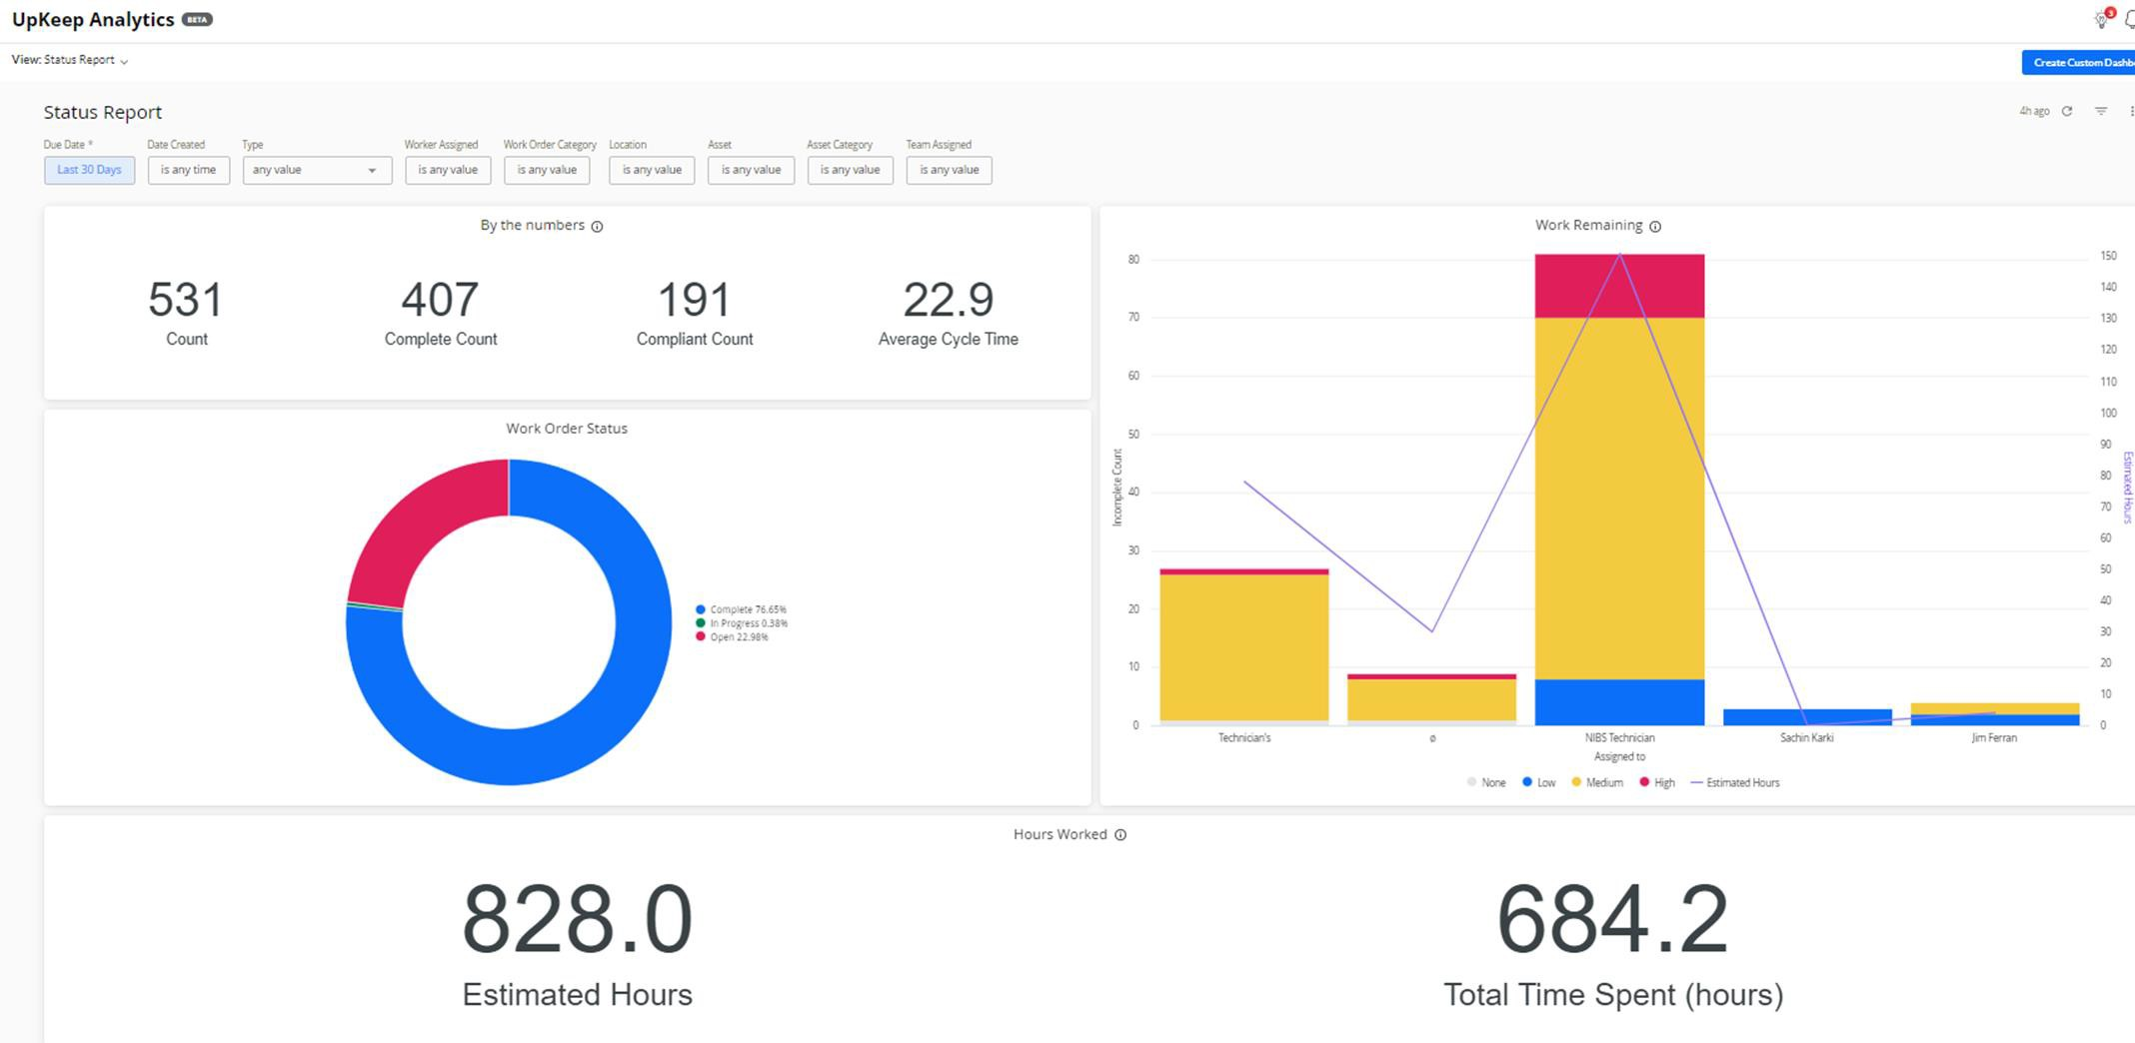
COMPUTER AIDED FACILITY MANAGEMENT (CAFM) SYSTEM
12

Slide 13


